Slide 1
MARY KOM
MADE BY- TANISHKA KHAIRE
TY BBA GeB
PRN NO. : 1062201694
ROLL NO. : 93

Slide 2
BIOGRAPHY OF MARY KOM
Mangte chungneijang mary kom ( born 24 November 1982 ) is an Indian amateur boxer,politician, and incumbent member of parliament, rajya sabha. She is the only female to win the world amateur boxing championship six times, the only female boxer to have won a medal in each one of the first seven world championships, and the only boxer ( male or female ) to win eight world championship medals. Nicknamed magnificent mary, she is the only Indian female boxer to have qualified for the 2012 summer Olympics, competing in the flyweight (51 kg) category and winning a bronze medal. She had also been ranked as the world no.1 female light-flyweight by the international boxing association (amateur) (AIBA).

Slide 3
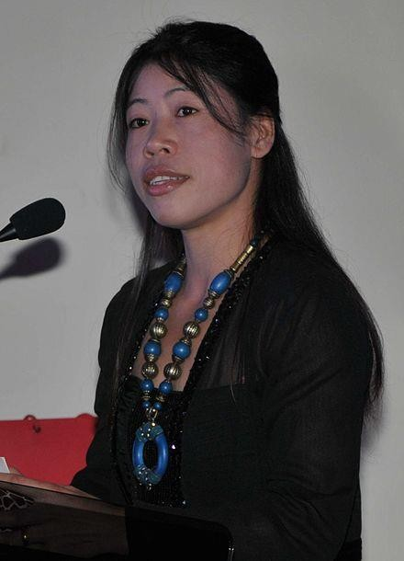
BIOGRAPHY OF MARY KOM
She became the first Indian female boxer to win a gold medal in the Asian games in 2014 at Incheon, south korea and is the first Indian female boxer to win gold at the 2018 commonwealth games. She is also the only boxer to become Asian amateur boxing champion for a record six times.
This Photo by Unknown Author is licensed under CC
BY-SA

Slide 4
BIRTH, NATIONALITY, AWARDS,WEIGHT CLASS, WEIGHT, HEIGHT
Born- chungneijang mary kom , 24 November 1982 age 38 (kangathei, Manipur, india)
Nationality- Indian
Awards- padma Vibhushan(2020), padma Bhushan(2013), padma shri(2006)
Weight class- atomweight, flyweight
Weight- 48 kg (106 lb)/ 51 kg ( 112 lb)
Height- 1.58m ( 5ft 2inch)

Slide 5
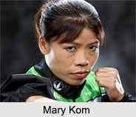
CAREER OF MARY KOM
This Photo by Unknown Author is licensed under CC BY-NC-ND
After her marriage, kom took a short hiatus from boxing.After she and onler had their first two children, kom again started training. She won a silver medal at the 2008 Asian women’s boxing championship in India and a fourth successive gold medal at 2008 AIBA women’s world boxing championship in china, followed by a gold medal at the 2009 Asian indoor games in Vietnam. In 2010, kom won the gold medal at Asian women’s boxing championship in kazaskhtan, and at the 2010 AIBA women’s boxing championship in Barbados, her fifth consecutive gold at the championship. She competed in Barbados in the 48 kg weight category, after AIBA had stopped using the 46 kg class. In the 2010 Asian games, she competed in the 51 kg class won the bronze medal, she won gold in china in Asian games in 48 kg.

Slide 6
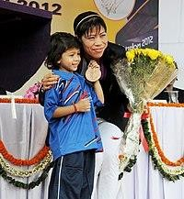
OLYMPIC GAMES OF MARY KOM
Kom, who had previously fought in the 46 and 48 kg category after the world body decided to allow women’s boxing in the only three weight categories eliminating the lower weight classes. At the 2012 AIBA women’s world boxing championship, kom was competing not just for the championship itself but also for a place at the 2012 summer Olympics in London, the first time
women’s boxing had featured as an
Olympic sport.
This Photo by Unknown Author is licensed under CC BY-SA

Slide 7




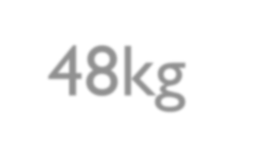





ACHIEVEMENT OF MARY KOM ( ONE OF THEM )
Year- 2001 Weight- 48kg
Competition- AIBA women’s world championships
Location- USA ( Scranton, Pennsylvania)

Slide 8
NATIONAL CHAMPIONSHIP OF MARY KOM
Gold- 1st women nat. boxing championship, Chennai 6/12 2001
The east open boxing champ, Bengal 11/14 December 2001
2nd sr world women boxing championship, new delhi 26/30 December 2001
National women sort meet, N. delhi 26/30 December 2001
32nd national games, Hyderabad 2002
3rd Sr world women boxing champ,Aizawl 4/8.3. 2003
4th Sr WWBC, kokrajar, assam 24/28 February 2004

Slide 10
THANKYOU

